Slide 1

Automated Skin Lesion Analyzer
1.Hrithik Prasad (18104038)
2.Aslam Pathan (18104057)
3.Zubair Mangral (17104072)
Project Guide
Prof. Sonal Balpande

Slide 2
Contents
Introduction
Literature Review
Objectives
Scope
Technology Stack
Block Diagram to propose project idea.
Demonstration (Desired)
References

Slide 3
1. Introduction
Automated skin lesion analyser will be a web application that can take affected skin lesion images and predict the dangerous disease like melanoma.
Problem Identified :
    Complexity in skin disease detection in rural area.
    Lack of knowledge about dangerous skin disease.
    Time requirement to visit dermatologist.
Solution Proposed :
    Automated image based system for recognition of skin disease.
    Convolution Neural Network for image identification.
    An efficient and dependable system for skin disease detection.

Slide 4
2. Literature Review
Sr.No. | Authors | Paper Title | Methodologies | Findings
1 | Santhi H, Gopichand G, K.Pavan Koushik, A.Nithin Krishna, D. Sai Tharun | An Automated Skin Lesion Analyser Using CNN with Adaptive Learning (2019) | Deep learning algorithm that includes convolutional neural network and residual network and to minimize the loss function of algorithm with respect to time we have used adaptive learning strategy so that w can obtain global minima of the loss function in comparatively less time | 1.Predict the disease up to 95% accuracy but due to small datasets may have bad prediction after few years 2.Disease that can be predicted are Melanocytic nevi, Melanoma, Benign keratosis, Basal cell carcinoma, Actinic Keratoses, Vascular skin lesions, Dermato fibroma
2 | J. Rathod, V. Waghmode, A.Sodha and P.Bhavathankar | Diagnosis of skin diseases using Convolutional Neural Networks (2018) | 1.Computational technique to analyse, process, and relegate the image data 2.Skin images are filtered to remove unwanted noise. 3.Feature extraction using CNN 4.Classify the image based on the algorithm of softmax classifier and obtain the diagnosis report as an output | 1.Initial training gives the accuracy of 70% approximately. This can be increased by increasing the training data set. 2.Five diseases were initial tested, which can be further increased in the future. A large data set can increase the accuracy to more than 90 percent

Slide 5
3. Objectives
To make a user friendly website to diagnose skin disease.
To classify 3 types of cancer like Melanoma, Basal-skin, Squamous-skin cell using CNN.
To use our trained model in our website to deploy and serve it online.
To reduce the human effort and costs with accuracy.

Slide 6
4. Scope
Can be used as a reliable real time teaching tool for medical students in the dermatology stream.
Can reduce the human effort.
Can be used in rural areas where dermatologist are hard to find.
Can save lives from early disease prediction.

Slide 7
5. Technology Stack
-Backend - TensorFlow.js (deep learning)
2. Frontend – Bootstrap, HTML, CSS, JavaScript
4. Database – MongoDB
5. HAM10000_metadata.csv dataset from kaggle

Slide 8
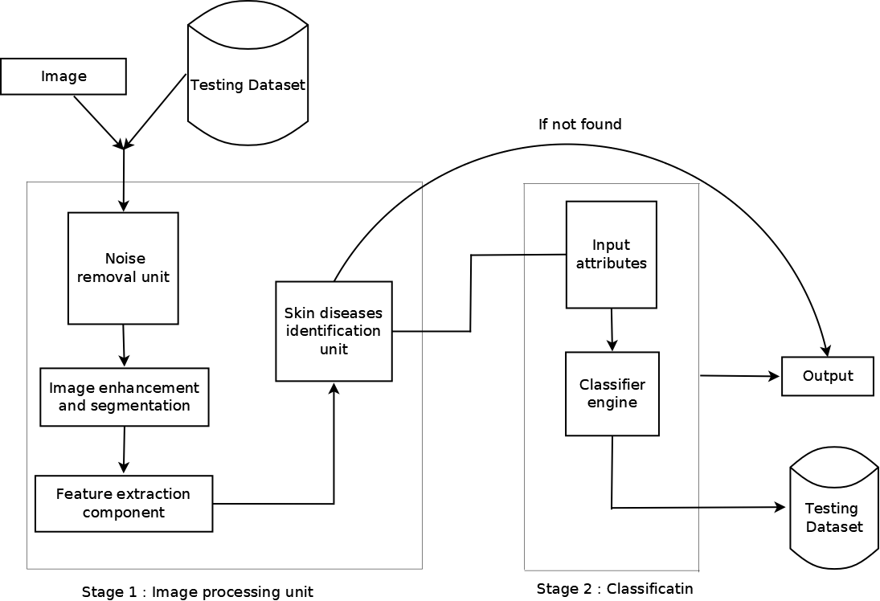
6. Block Diagram to propose project Idea
stage1-Image Processing Unit
Stage2- Classification

Slide 9
8. References
1. C. Huang, Y. Yu and M. Qi, "Skin Lesion Segmentation Based on Deep Learning," 2020 IEEE 20th International Conference on Communication Technology (ICCT), 2020, pp. 1360-1364, doi: 10.1109/ICCT50939.2020.9295941.
2..J. Rathod, V. Waghmode, A. Sodha and P. Bhavathankar, "Diagnosis of skin diseases using Convolutional Neural Networks," 2018 Second International Conference on Electronics, Communication and Aerospace Technology (ICECA), 2018, pp. 1048-1051, doi: 10.1109/ICECA.2018.8474593.

Slide 10
Thank You...!!

